Slide 1
Data Encryption Standard (DES)
.

Slide 2
CONFUSION VS DIFFUSION
Confusion: is an encryption operation where the relationship between key and ciphertext is obscured. A common element for achieving confusion is substitution.
Diffusion: is an encryption operation where the influence of one plaintext symbol is spread over many ciphertext symbols with the goal of hiding statistical properties of the plaintext.
A simple diffusion element is the bit permutation, which is used frequently within DES.
.

Slide 3
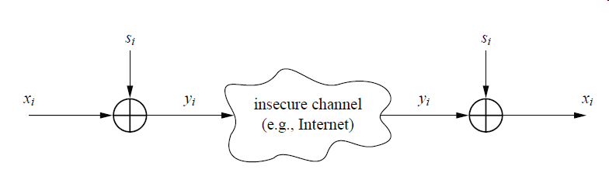
.

Slide 4
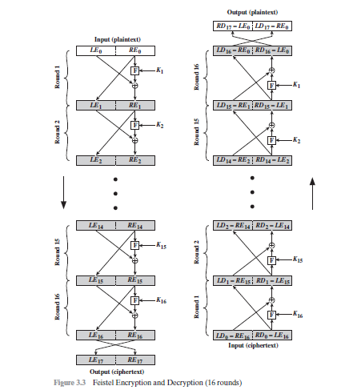
Feistel structure
.

Slide 5
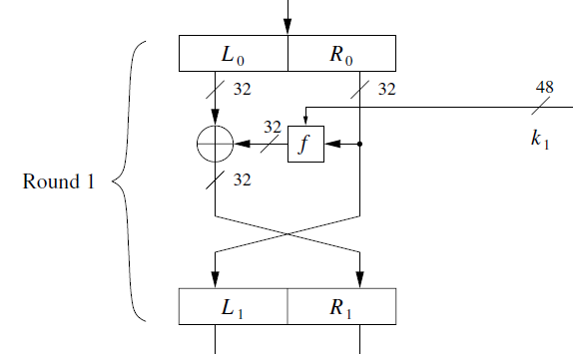
Feistel structure
.

Slide 6
Feistel structure
.

Slide 7
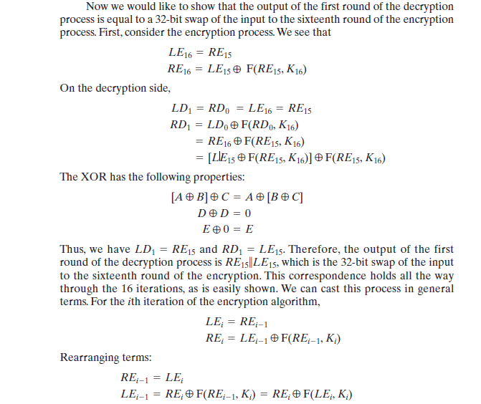
Feistel structure
.

Slide 8
Data Encryption Standard (DES)
Data DES is a symmetric-key block cipher.
Published by the National Institute of Standards and Technology (NIST).
History
In 1973, NIST published a request for proposals for a national symmetric-key cryptosystem.
A proposal from IBM, a modification of a project called Lucifer, was accepted as DES.
DES was published in the Federal Register in March 1975 as a draft of the Federal Information Processing Standard (FIPS).
.

Slide 9
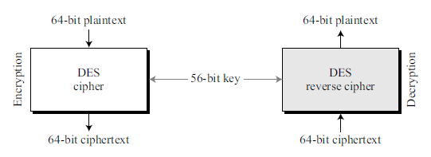
Overview
DES is a block cipher, as shown in Figure 6.1.
DES takes a 64-bit plaintext and creates a 64-bit ciphertext;
DES takes a 64-bit ciphertext and creates a 64-bit plaintext.
The same 56-bit cipher key is used for both encryption and decryption.
.

Slide 10
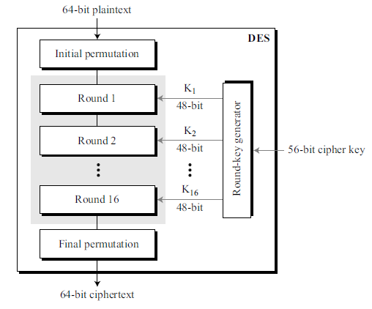
6.2 DES STRUCTURE
Figure 6.2 : elements of DES cipher at the encryption site.
The encryption process is made of two permutations (P-boxes), which is initial and final permutations, and 16 Feistel rounds.
Each round uses a different 48-bit round key generated from the cipher key according to a predefined algorithm.
.

Slide 11
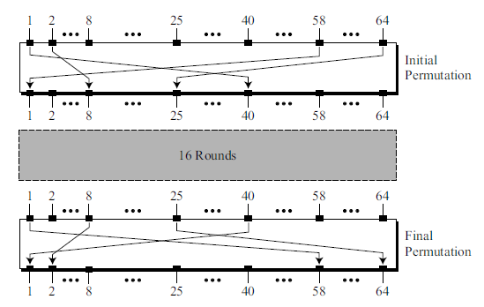
Initial and Final Permutations
Figure 6.3 : initial and final permutations (P-boxes).
Each of these permutations takes a 64-bit input and permutes them according to a predefined rule.
These permutations are keyless straight permutations that are the inverse of each other.
For example, in the initial permutation, the 58th bit in the input becomes the first bit in the output.
.

Slide 12
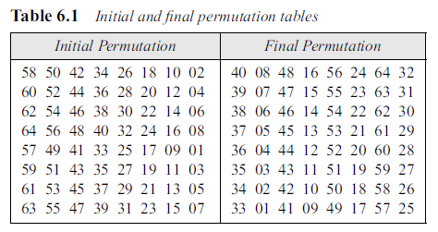
Table 6.1 is the the permutation rules for these P-boxes.
Each side of the table can be thought of as a 64-element array.
Here the value of each element defines the input port number, and the order (index) of the element defines the output port number.
.

Slide 13
These two permutations have no cryptography significance in DES.
Both permutations are keyless and predetermined.
The reason they are included in DES is not clear and has not been revealed by the DES designers.
.

Slide 14
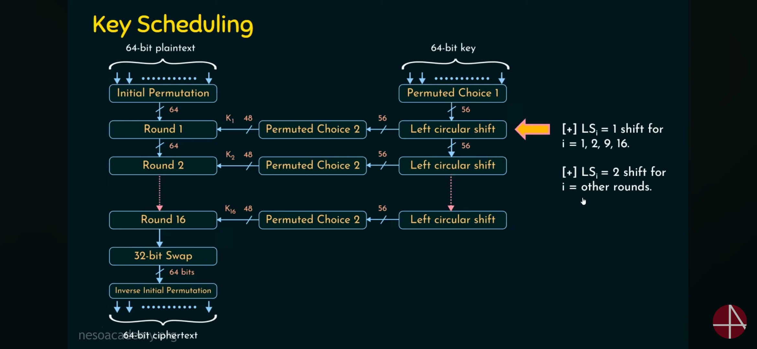
.

Slide 15

.

Slide 16
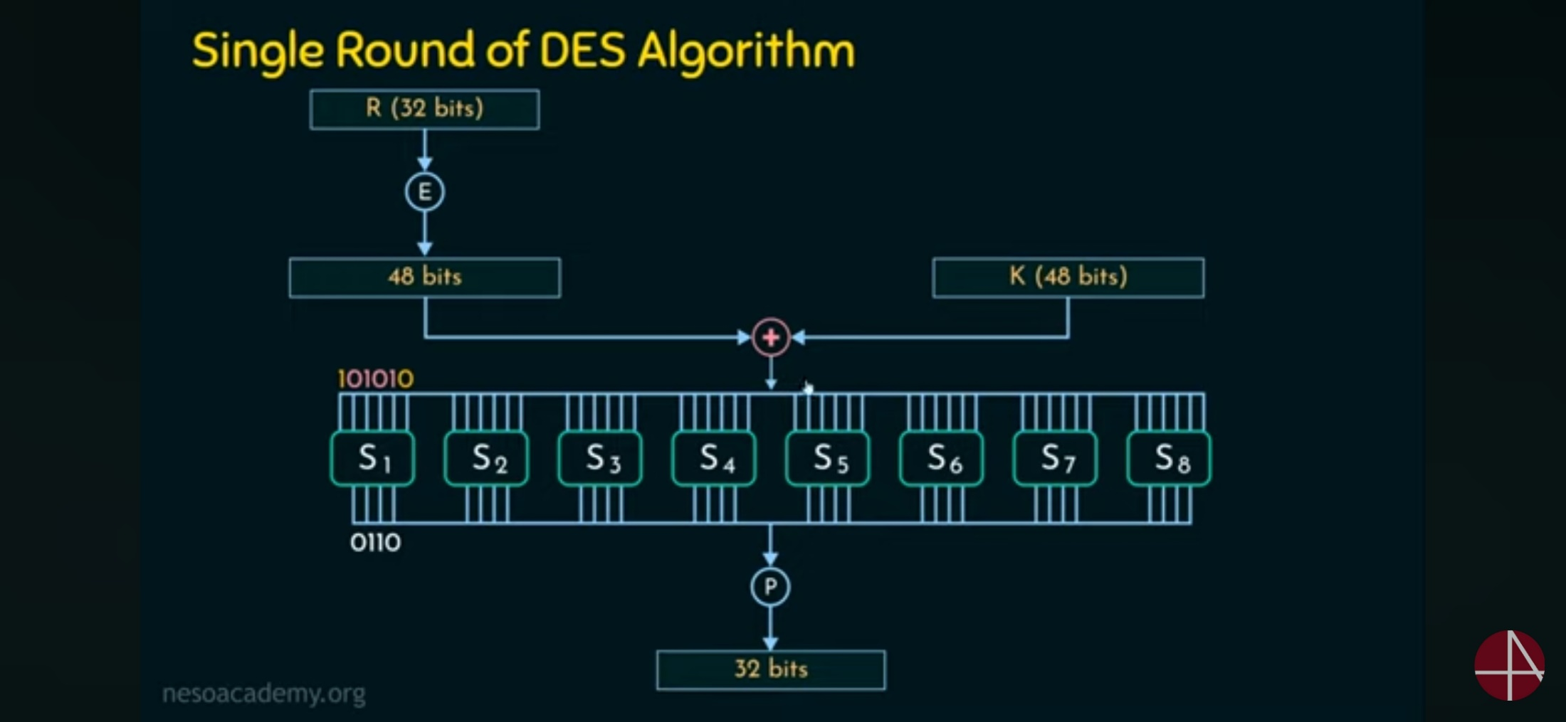
.

Slide 17
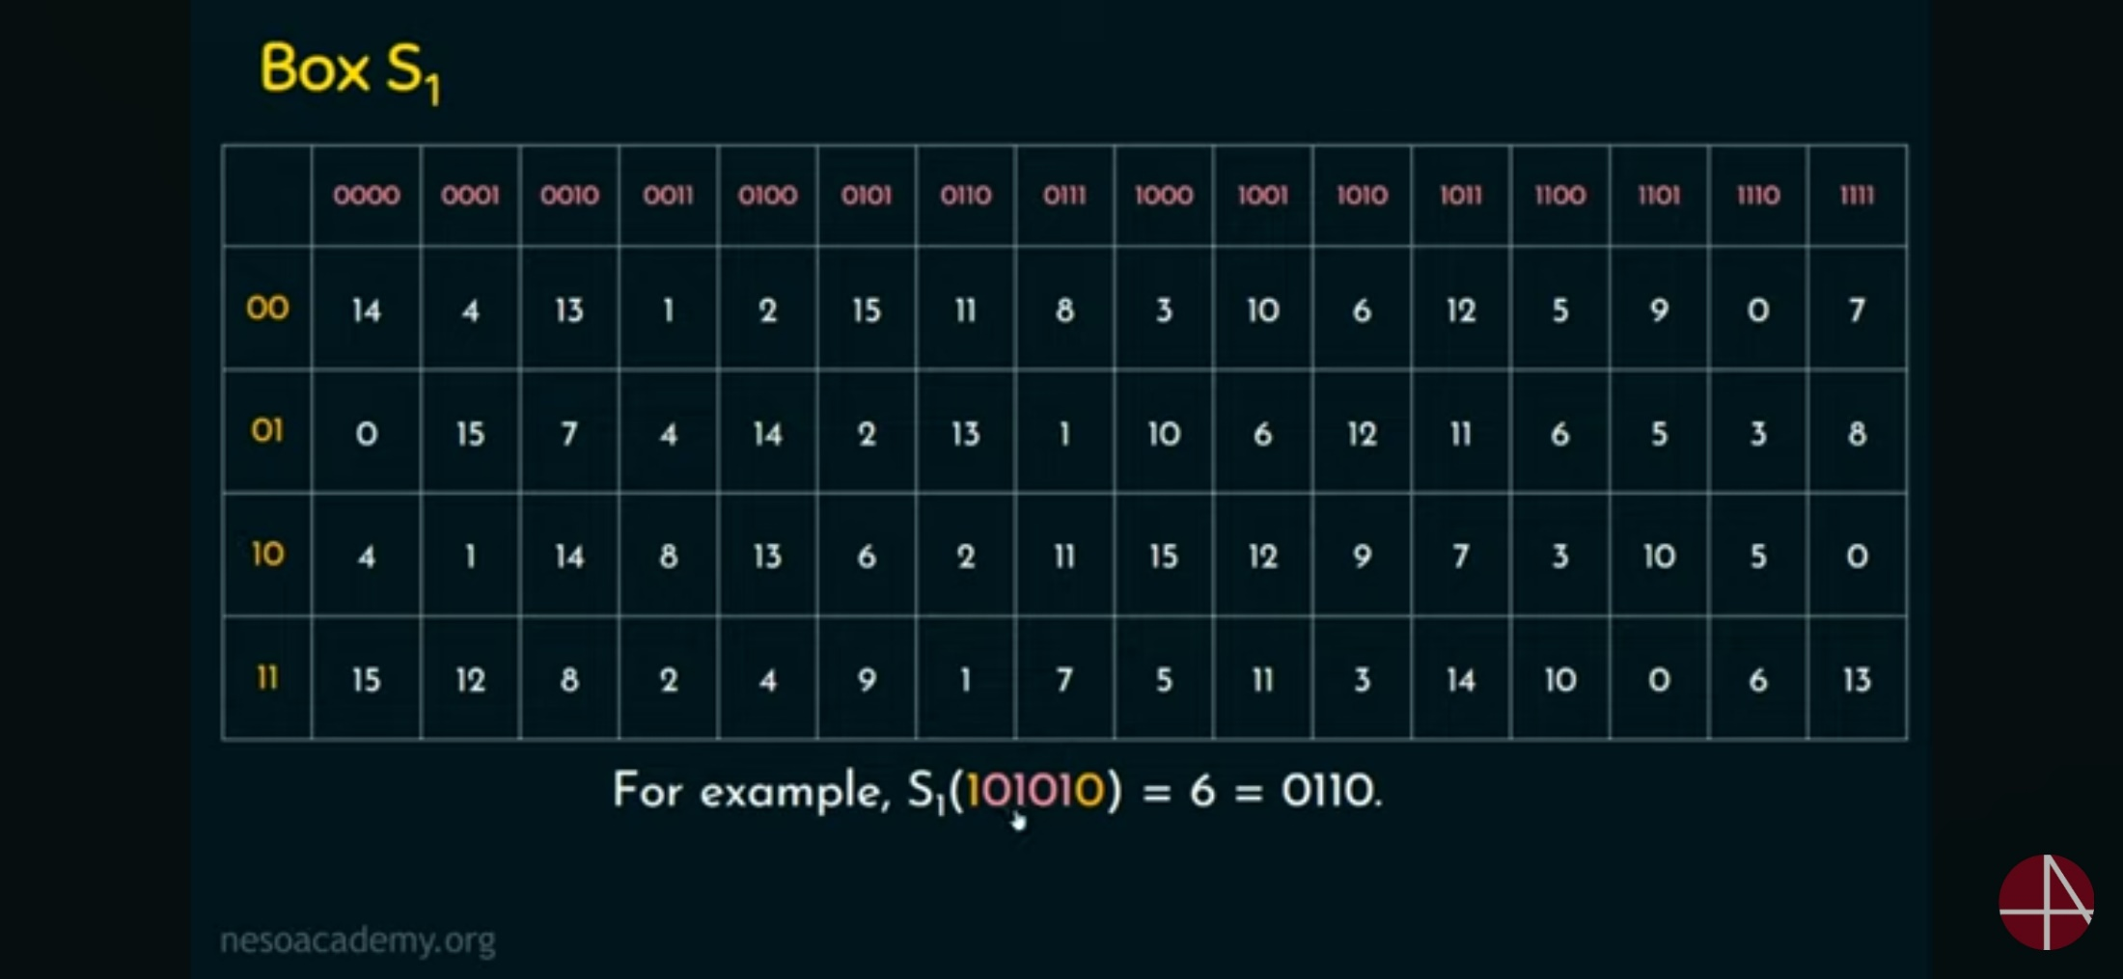
.

Slide 18
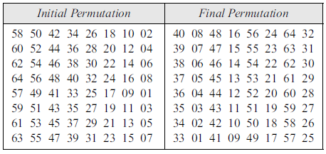
Example 6.1
Find the output of the initial permutation box when the input is given in hexadecimal as:
Solution
The input has only two 1s (bit 15 and bit 64);
the output must also have only two 1s (the nature of straight permutation).
Using Table 6.1, we can find the output related to these two bits.
Bit 15 in the input becomes bit 63 in the output.
Bit 64 in the input becomes bit 25 in the output.
So the output has only two 1s, bit 25 and bit 63.
The result in hexadecimal is
.

Slide 19
Example 6.1
Find the output of the initial permutation box when the input is given in hexadecimal as:
Solution
The input has only two 1s (bit 15 and bit 64);
the output must also have only two 1s (the nature of straight permutation).
Using Table 6.1, we can find the output related to these two bits.
Bit 15 in the input becomes bit 63 in the output.
Bit 64 in the input becomes bit 25 in the output.
So the output has only two 1s, bit 25 and bit 63.
The result in hexadecimal is
.

Slide 20

Example 6.2
Prove that the initial and final permutations are the inverse of each other by finding the output of the final permutation if the input is
Solution
Only bit 25 and bit 64 are 1s; the other bits are 0s. In the final permutation, bit 25 becomes bit 64 and bit 63 becomes bit 15. The result is
.

Slide 21
Example 6.2
Prove that the initial and final permutations are the inverse of each other by finding the output of the final permutation if the input is
Solution
Only bit 25 and bit 64 are 1s; the other bits are 0s. In the final permutation, bit 25 becomes bit 64 and bit 63 becomes bit 15. The result is
.

Slide 22
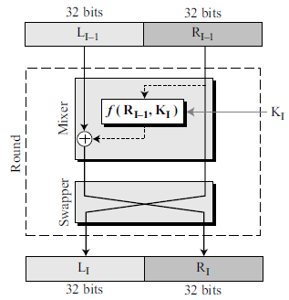
Rounds
DES uses 16 rounds. Each round of DES is a Feistel cipher.
.

Slide 23
The round takes L_{I−1} and R_{I−1} from previous round (or the initial permutation box)
and creates L_{I} and R_{I}, which go to the next round (or final permutation box).
Each round has two cipher elements (mixer and swapper).
Each of these elements is invertible.
The swapper is obviously invertible. It swaps the left half of the text with the right half.
The mixer is invertible because of the XOR operation.
All noninvertible elements are collected inside the function f (R_{I−1}, K_{I}).
.

Slide 24
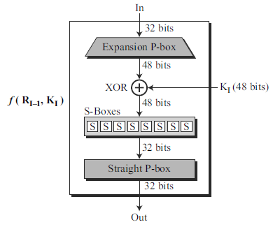
DES Function
The heart of DES is the DES function.
DES function applies a 48-bit key to the rightmost 32 bits (R_{I−1}) to produce a 32-bit output.
This function is made up of 4 sections:
an expansion P-box,
a whitener (that adds key),
a group of S-boxes, and
a straight P-box.
.

Slide 25
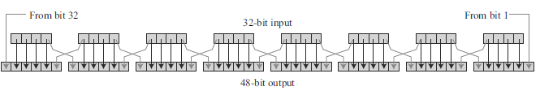
Expansion P-box
R_{I−1} is divided into 8 4-bit sections. Each 4-bit section is then expanded to 6 bits.
Expansion permutation
This expansion permutation follows a predetermined rule.
For each Section
Input bits 1, 2, 3, and 4 are copied to output bits 2, 3, 4, and 5, respectively.
Output bit 1 comes from bit 4 of the previous section;
output bit 6 comes from bit 1 of the next section.
If sections 1 and 8 can be considered adjacent sections, the same rule applies to bits 1 and 32.
.

Slide 26
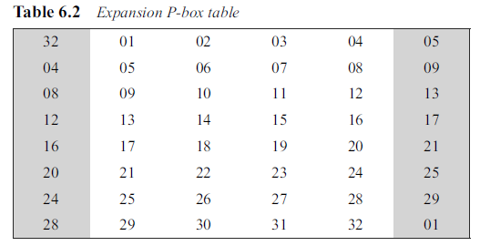
Table 6.2 to define this P-box.
Number of output ports is 48, but the value range is only 1 to 32. Some of the inputs go to more than one output.
.

Slide 27
Whitener (XOR)
After the expansion permutation, DES uses the XOR operation on the expanded right section and the round key.
Note that both the right section and the key are 48-bits in length.
.

Slide 28
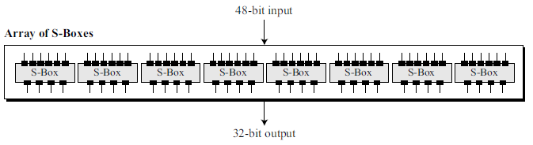
S-Boxes
The S-boxes do the real mixing (confusion).
DES uses 8 S-boxes, each with a 6-bit input and a 4-bit output.
48-bit data from the second operation is divided into eight 6-bit chunks, and each chunk is fed into a box.
Result of each box is a 4-bit chunk; when these are combined the result is a 32-bit text.
.

Slide 29
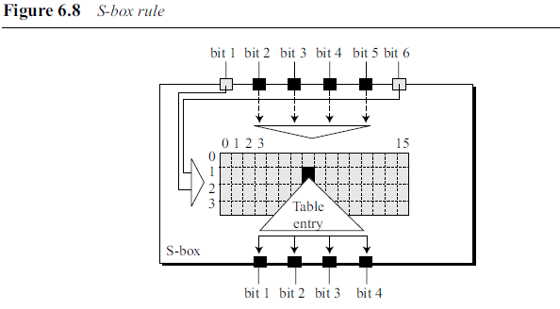
Substitution in each box follows a pre-determined rule based on a 4-row by 16-column table.
Combination of bits 1 and 6 of the input defines one of four rows;
Combination of bits 2 through 5 defines one of the sixteen columns
.

Slide 30
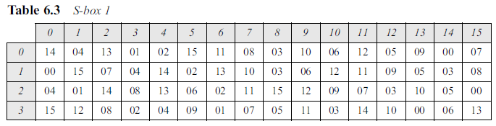
Because each S-box has its own table, we need 8 tables, as shown in Tables 6.3 to 6.10, to define the output of these boxes.
The values of the inputs (row number and column number) and the values of the outputs are given as decimal numbers to save space. These need to be changed to binary.
.

Slide 31
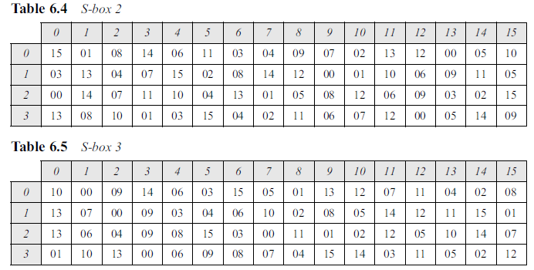
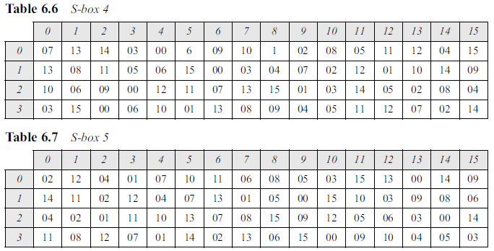
.

Slide 32
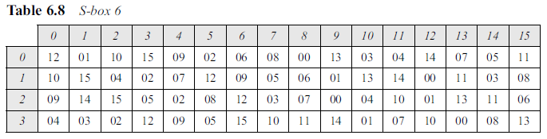
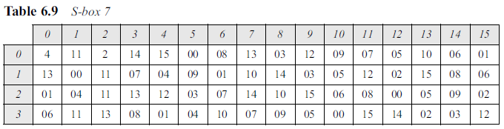
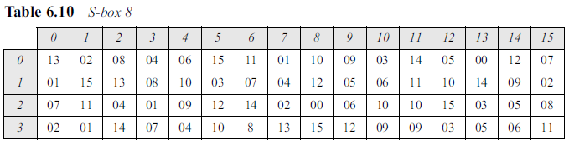
.

Slide 33
Example 6.3 : The input to S-box 1 is 100011. What is the output?
.

Slide 34
Example 6.3 : The input to S-box 1 is 100011. What is the output?
Solution
If we write the first and the sixth bits together, we get 11 in binary, which is 3 in decimal. The remaining bits are 0001 in binary, which is 1 in decimal. We look for the value in row 3, column 1, in Table 6.3 (S-box 1).
The result is 12 in decimal, which in binary is 1100.
.

Slide 35
Example 6.4 : The input to S-box 8 is 000000. What is the output?
.

Slide 36
Example 6.4 : The input to S-box 8 is 000000. What is the output?
Solution
If we write the first and the sixth bits together, we get 00 in binary, which is 0 in decimal.
The remaining bits are 0000 in binary, which is 0 in decimal. We look for the value in row 0, column 0, in Table 6.10 (S-box 8).
The result is 13 in decimal, which is 1101 in binary.
.

Slide 37
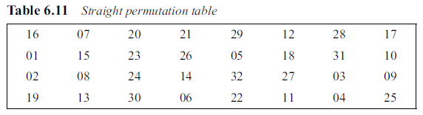
Straight Permutation
Last operation in the DES function is a straight permutation with a 32-bit input and a 32-bit output.
The input/output relationship for this operation is shown in and follows the same general rule as previous permutation tables.
For example, the 7th bit of the input becomes the 2nd bit of the output.
.

Slide 38
Cipher and Reverse Cipher
Using mixers and swappers, we can create the cipher and reverse cipher, each having 16 rounds.
The cipher is used at the encryption site;
The reverse cipher is used at the decryption site.
The whole idea is to make the cipher and the reverse cipher algorithms similar.
.

Slide 39
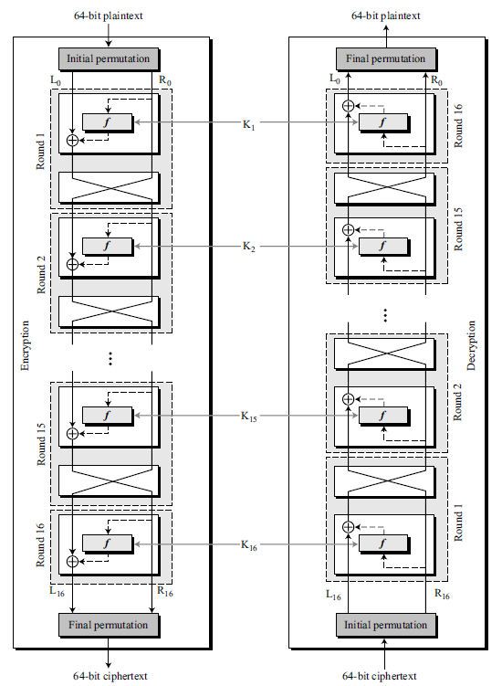
First Approach
To achieve this goal, one approach is to make the last round (round 16) different from the others; it has only a mixer and no swapper.
This is done in Figure 6.9.
.

Slide 40
Although the rounds are not aligned, the elements (mixer or swapper) are aligned.
Mixer is a self-inverse; so is a swapper.
The final and initial permutations are also inverses of each other.
The left section of the plaintext at the encryption site, L₀, is enciphered as L₁₆ at the encryption site;
L₁₆ at the decryption is deciphered as L₀ at the decryption site.
The situation is the same with R₀ and R₁₆.
.

Slide 41
The round keys (K₁ to K₁₆) should be applied in the reverse order.
At the encryption site, round 1 uses K₁ and round 16 uses K₁₆;
at the decryption site, round 1 uses K₁₆ and round 16 uses K₁.
.

Slide 42
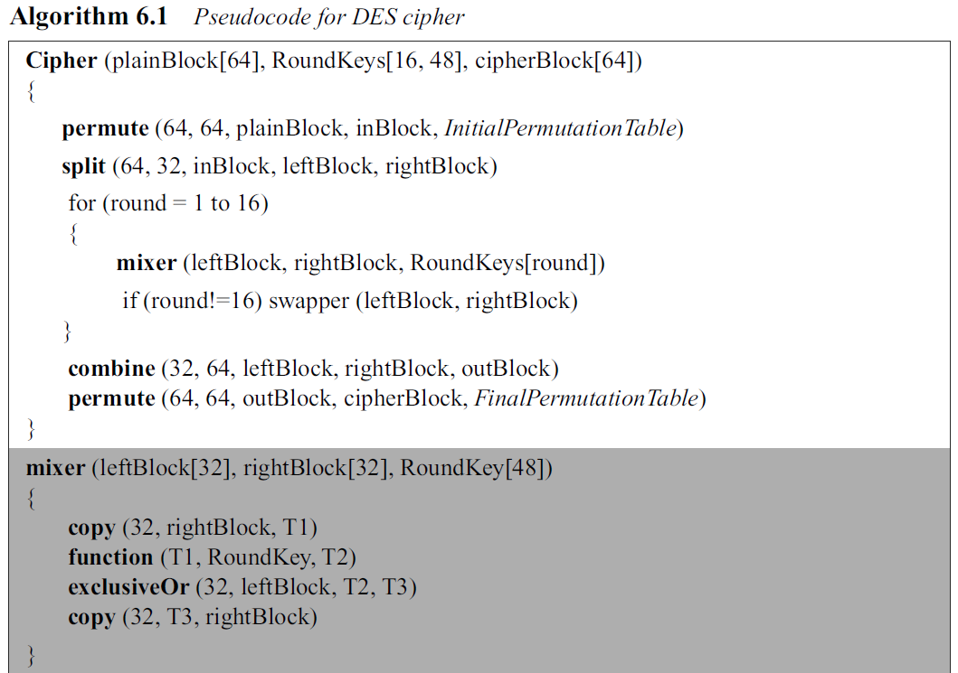
.

Slide 43
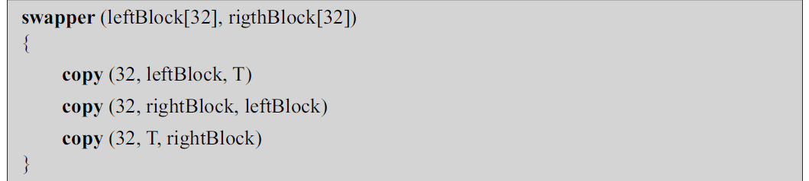
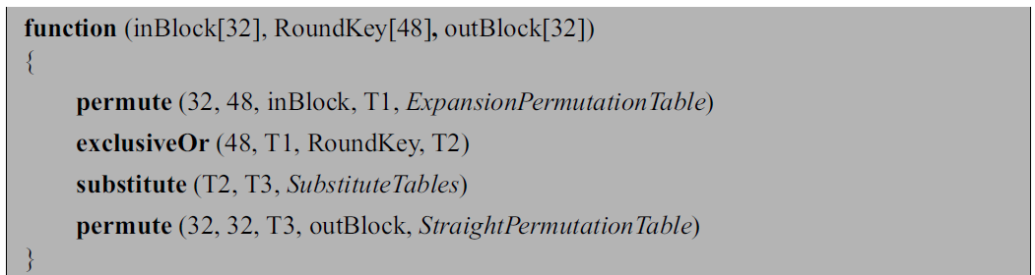
.

Slide 44
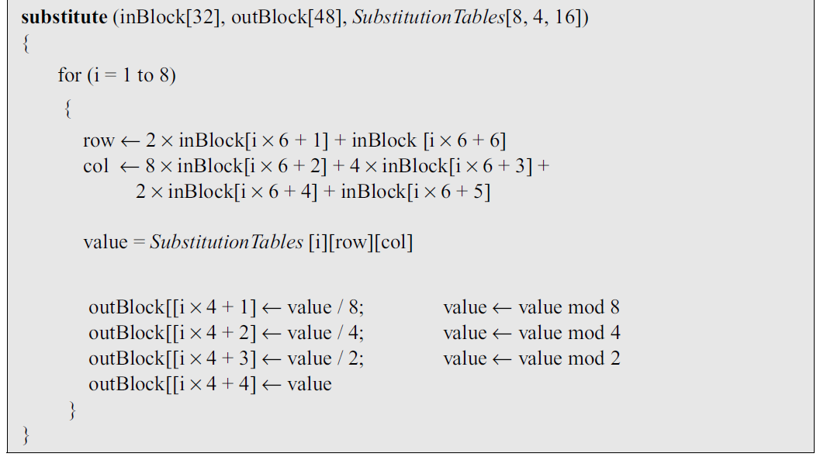
.

Slide 45
Alternative Approach
In the first approach, round 16 is different from other rounds; there is no swapper in this round.
This is needed to make the last mixer in the cipher and the first mixer in the reverse cipher aligned.
We can make all 16 rounds the same by including one swapper to the 16th round and add an extra swapper after that (two swappers cancel the effect of each other).
.

Slide 46
Key Generation
The round-key generator creates sixteen 48-bit keys out of a 56-bit cipher key.
However, the cipher key is normally given as a 64-bit key in which 8 extra bits are the parity bits, which are dropped before the actual key-generation process, as shown in Figure 6.10.
.

Slide 47
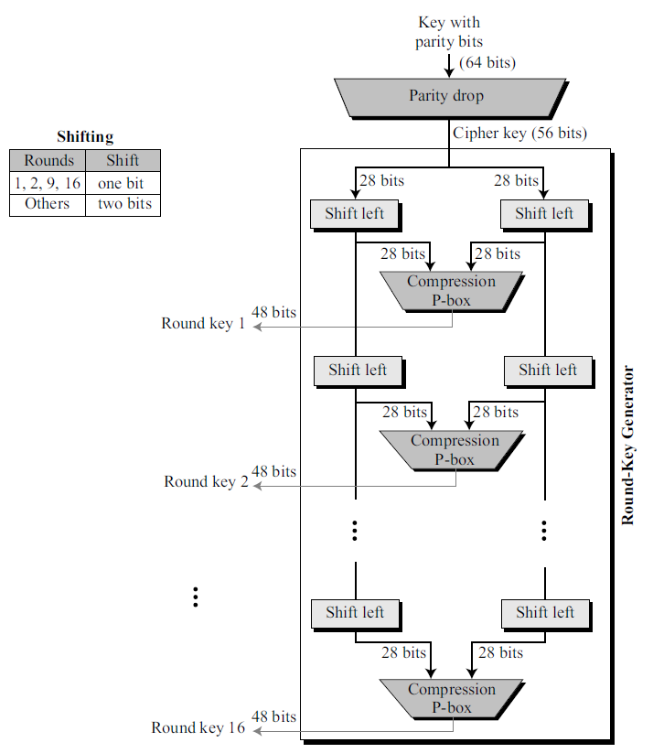
.

Slide 48
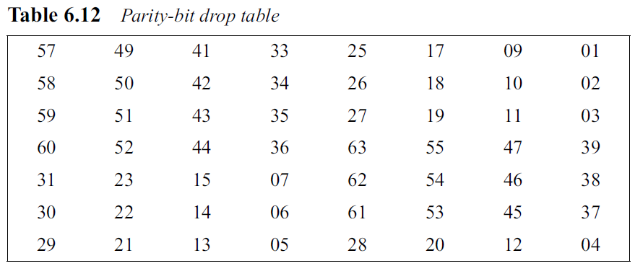
Parity Drop
It drops the parity bits (bits 8, 16, 24, 32, …, 64) from the 64-bit key and permutes the rest of the bits according to Table 6.12.
The remaining 56-bit value is the actual cipher key which is used to generate round keys.
The parity drop permutation (a compression P-box) is shown in Table 6.12.
.

Slide 49
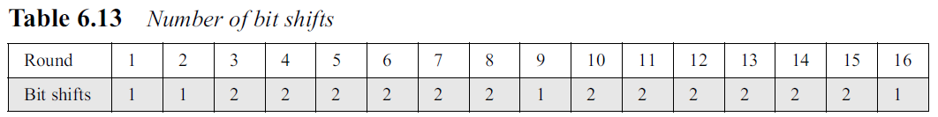
Shift Left
After the straight permutation, the key is divided into two 28-bit parts.
Each part is shifted left (circular shift) one or two bits.
In rounds 1, 2, 9, and 16, shifting is one bit; in the other rounds, it is two bits.
The two parts are then combined to form a 56-bit part.
Table 6.13 shows the number of shifts for each round.
.

Slide 50
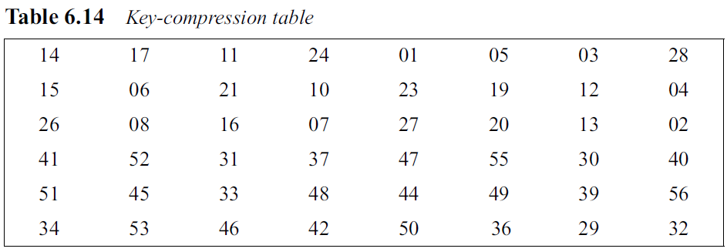
Compression Permutation
The compression permutation (P-box) changes the 58 bits to 48 bits, which are used as a key for a round.
The compression permutation is shown in Table 6.14.
.

Slide 51
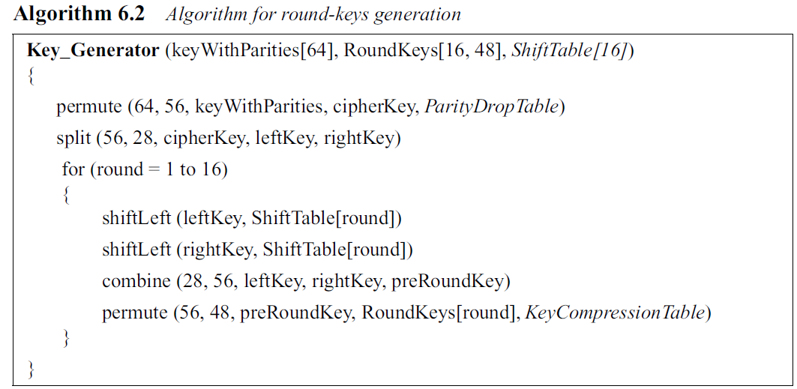
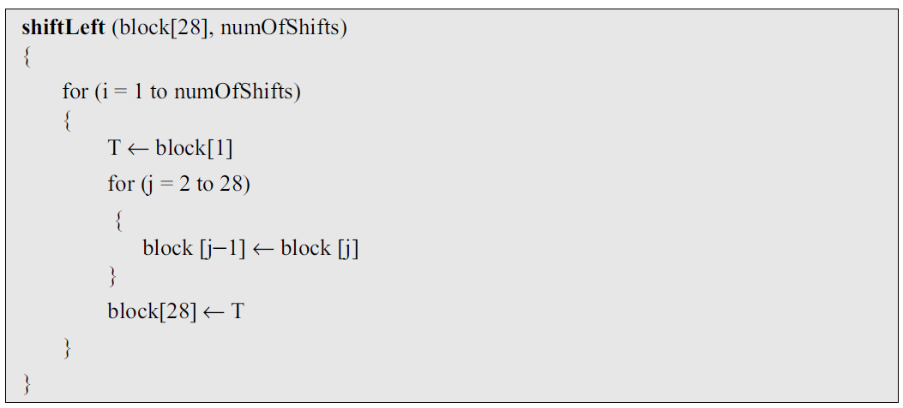
.

Slide 52
Example 6.5
.

Slide 53
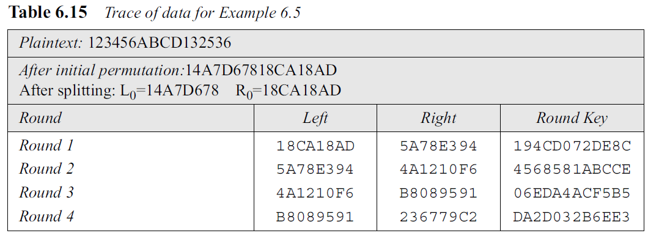
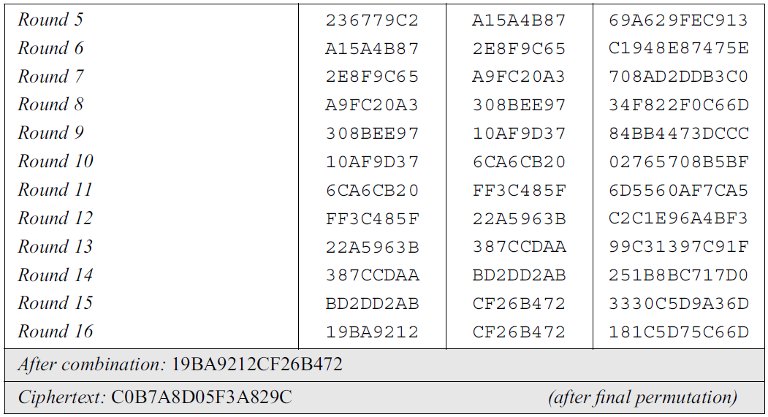
Example 6.5
.

Slide 54
Some points are worth mentioning here.
First, the right section out of each round is the same as the left section out of the next round.
The reason is that the right section goes through the mixer without change, but the swapper moves it to the left section.
For example, R₁ passes through the mixer of the second round without change, but then it becomes L₂ because of the swapper.
The interesting point is that we do not have a swapper at the last round. That is why R₁₅ becomes R₁₆ instead of becoming L₁₆.
.

Slide 55
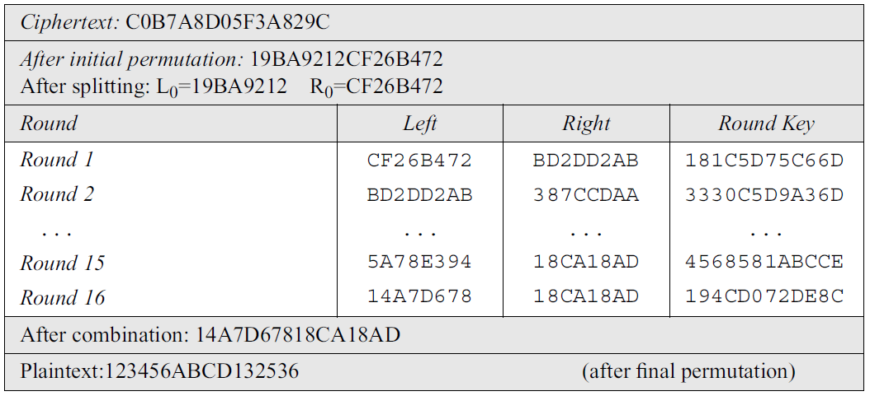
Example 6.6
At the destination, Bob decipher the ciphertext received from Alice using the same key.
.

Slide 56
6.3 DES ANALYSIS
Properties
Two desired properties of a block cipher are the avalanche effect and the completeness.
Avalanche Effect
Avalanche effect means a small change in the plaintext (or key) should create a significant change in the ciphertext.
DES has been proved to be strong with regard to this property.
.

Slide 57
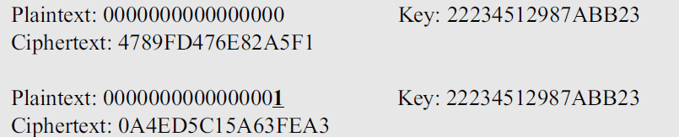
6.3 DES ANALYSIS
Example : Encrypt 2 plaintext blocks (with the same key) that differ only in one bit.
Although the two plaintext blocks differ only in the rightmost bit, the ciphertext blocks differ in 29 bits.
This means that changing approximately 1.5 percent of the plaintext creates a change of approximately 45 percent in the ciphertext.
.

Slide 58
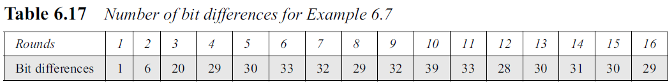
6.3 DES ANALYSIS
Table 6.17 shows the change in each round. It shows that significant changes occur as early as the third round.
.

Slide 59
6.3 DES ANALYSIS
Completeness effect
Completeness effect means that each bit of the ciphertext needs to depend on many bits on the plaintext.
The diffusion and confusion produced by P-boxes and S-boxes in DES, show a very strong completeness effect.
.

Slide 60
6.4 MULTIPLE DES
With available technology and the possibility of parallel processing, a brute-force attack on DES is feasible.
One solution to improve the security of DES is to abandon DES and design a new cipher. ( advent of AES.)
The second solution is to use multiple (cascaded) instances of DES with multiple keys;
.

Slide 61
Double DES
The first approach is to use double DES (2DES).
This approach use two instances of DES ciphers for encryption and two instances of reverse ciphers for decryption.
Each instance uses a different key, which means that the size of the key is now doubled (112 bits).
Double DES is vulnerable to a known-plain text attack.
.

Slide 62
Triple DES
To improve the security of DES, triple DES (3DES) was proposed.
This uses three stages of DES for encryption and decryption.
Two versions of triple DES are in use today:
triple DES with two keys and
triple DES with three keys.
.

Slide 63
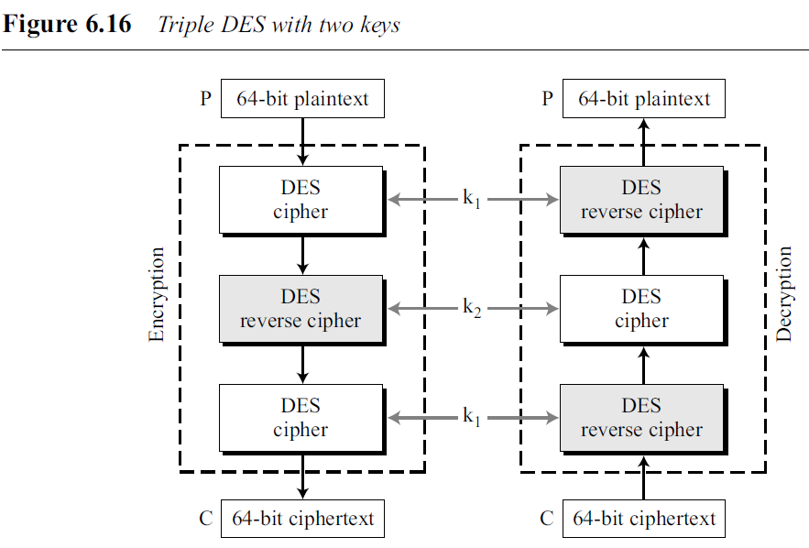
Triple DES with Two Keys
In triple DES with two keys, there are only two keys: k1 and k2.
The first and the third stages use k1; the second stage uses k2.
.

Slide 64
Triple DES with Three Keys
The possibility of known-plaintext attacks on triple DES with two keys has enticed some applications to use triple DES with three keys.
.

Slide 65
.

